Slide 1

EXCELENCE AND TECHNOLOGY

Slide 2

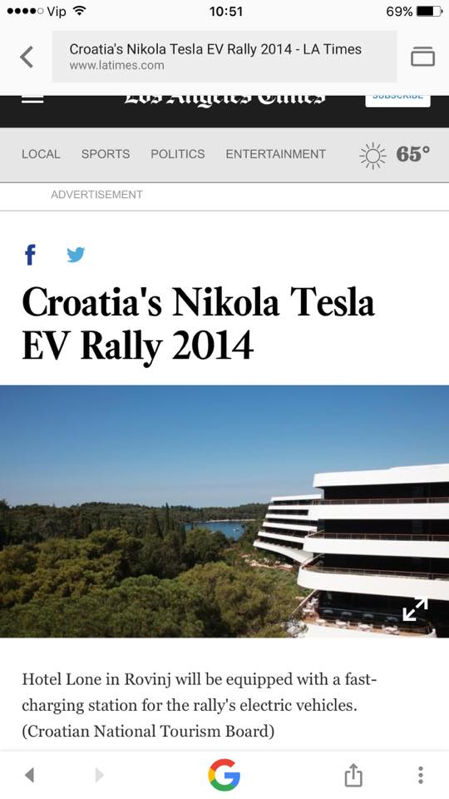
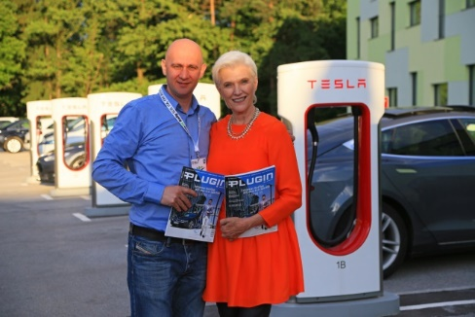
Nikola Tesla ev rally- INTRODUCTION
"Nikola Tesla EV Rally Croatia is the first rally exclusively held for electric vehicles in this part of Europe and the only in the world of this type.
The rally is being held for the fith year in a row and it has international character. 98% of the participants are from abroad (Germany, Austria, Belgium, Finland, Norway,Netherlands, Slovenia, the USA and Canada. The participants are domestic and foreign
e-mobilists, entrepreneurs, globetrotters, tourists and adventurers.
IDEA The rally is a joint cooperation and integration of partners, cities and towns, tourist offices and affiliated institutions in order to establish the infrastructure for electric vehicles. Setting up charging stations, the promotion of green technologies, renewable sources of energy, ecology, Croatian excellence as well as the natural beauty and the best domestic brands and companies. On the route of the rally we've set up (and are setting up) charging station for electric vehicles on the most attractive tourist locations (Rovinj, NP Paklenica, Smiljan, Poreč, ...) and we have established a "Green electric tourist Highway".
Among the guests was also Maye Musk, a model and a nutritionist and also the mother of Elon Musk

Slide 3
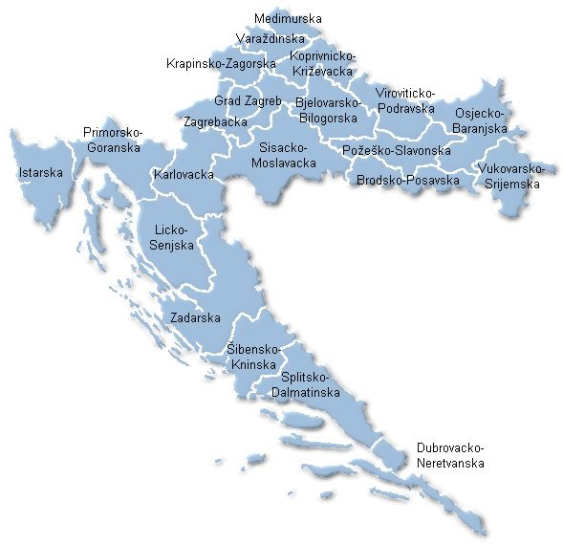
Nikola tesla ev rally Croatia 2018
ROUTE 2018:
03.06. START ROVINJ
04.06. ROVINJ-POREČ-ŠIŠAN-VRSAR
05.06. ROVINJ-MOTOVUN-BUZET-CRES-MALI LOŠINJ
06.06. MALI LOŠINJ
07.06. MALI LOŠINJ-CRES-KRK-PAG-ZADAR
08.06. ZADAR-KORNATI
09.06. ZADAR- MC NIKOLA TESLA SMILJAN GOSPIĆ-NP PLITVIČKA JEZERA-ZAGREB
10.06. FINISH ZAGREB

Slide 4
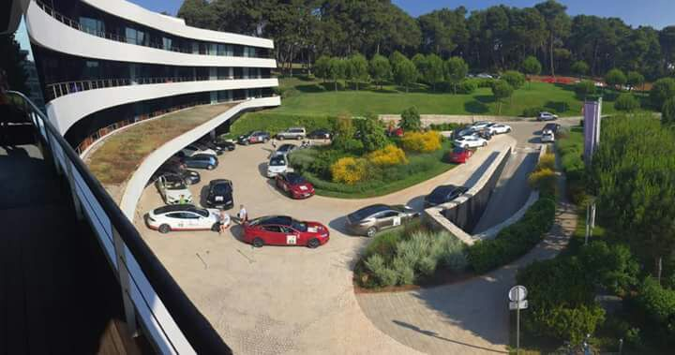
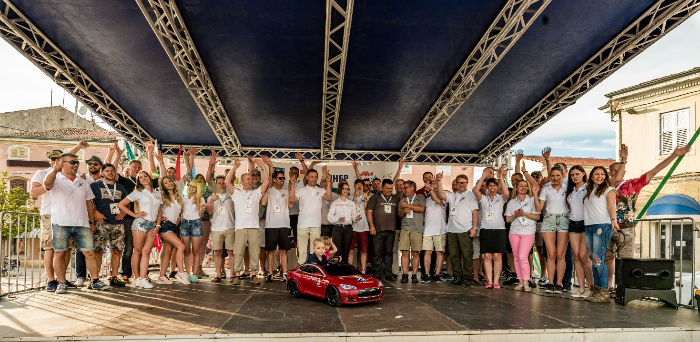
Nikola tesla ev RALLY CROATIA 2018
DAY 03.06. ROVINJ (hotel Lone)
Introduction
Presentation of rally and team
Socializing and party

Slide 5
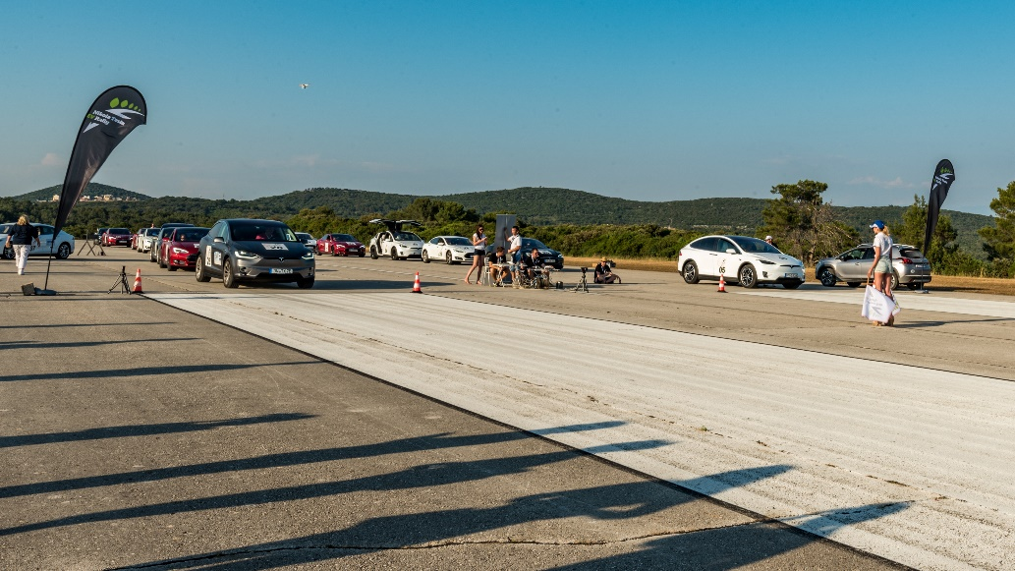
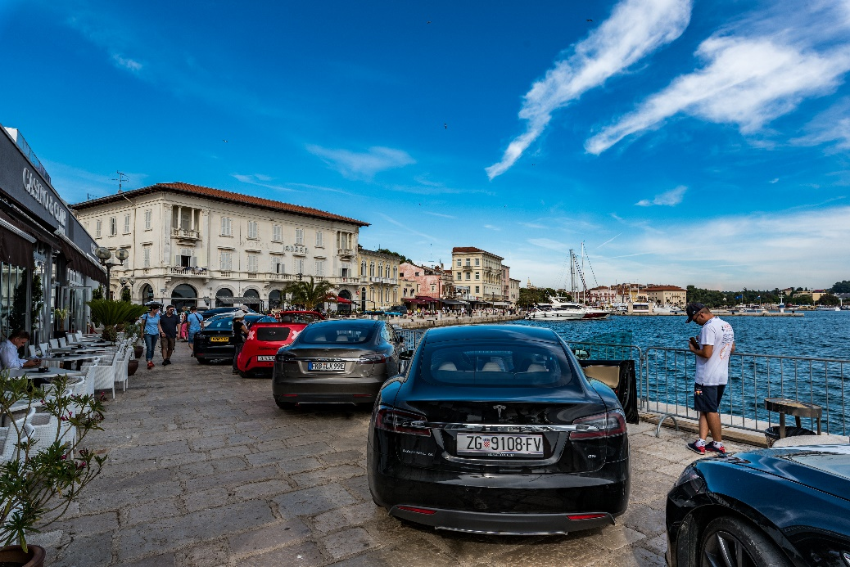
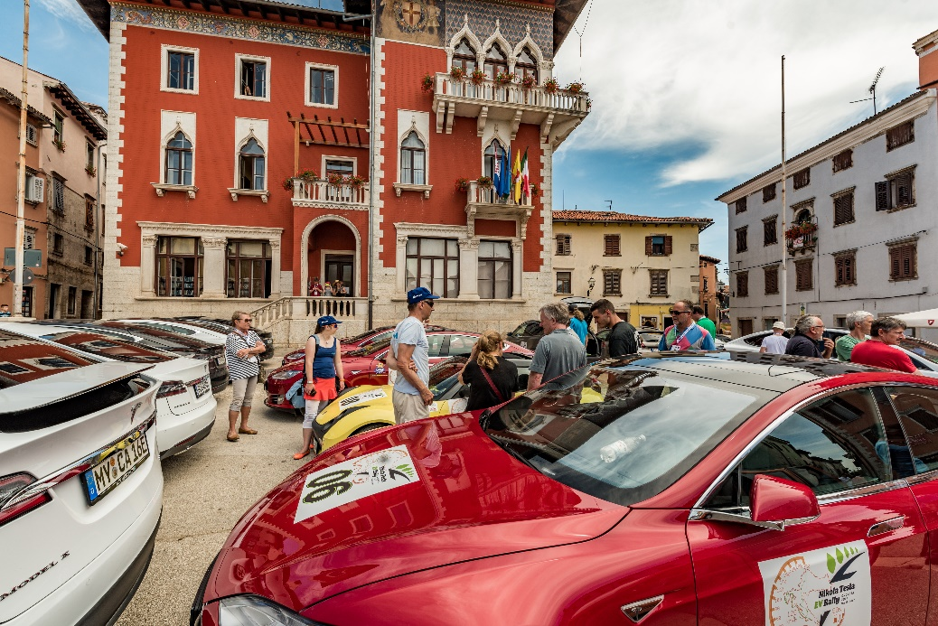
Nikola tesla ev RALLY CROATIA 2018
DAY 04.06. START Rovinj-Poreč
- Vrsar
Poreč: Skill exam
Vrsar (airport): “Speed race”
Lunch: Trapan winery – Šišan

Slide 6
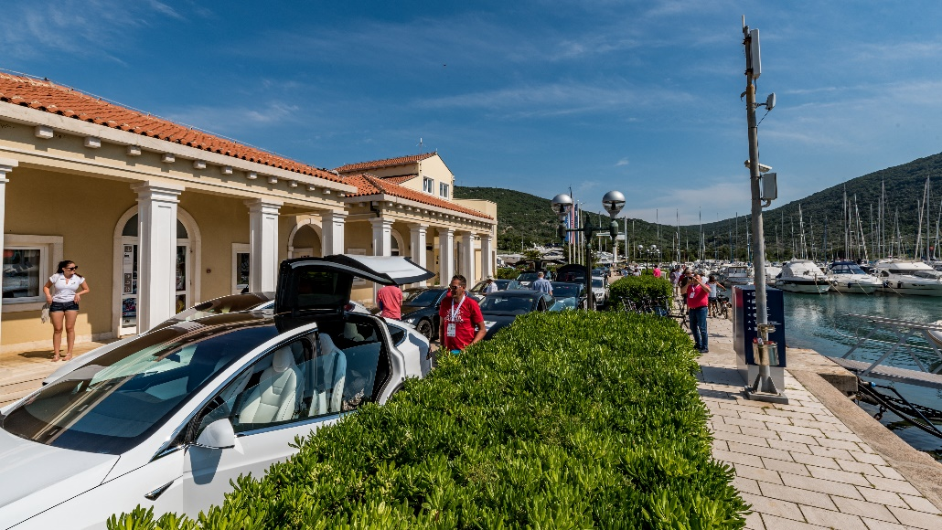
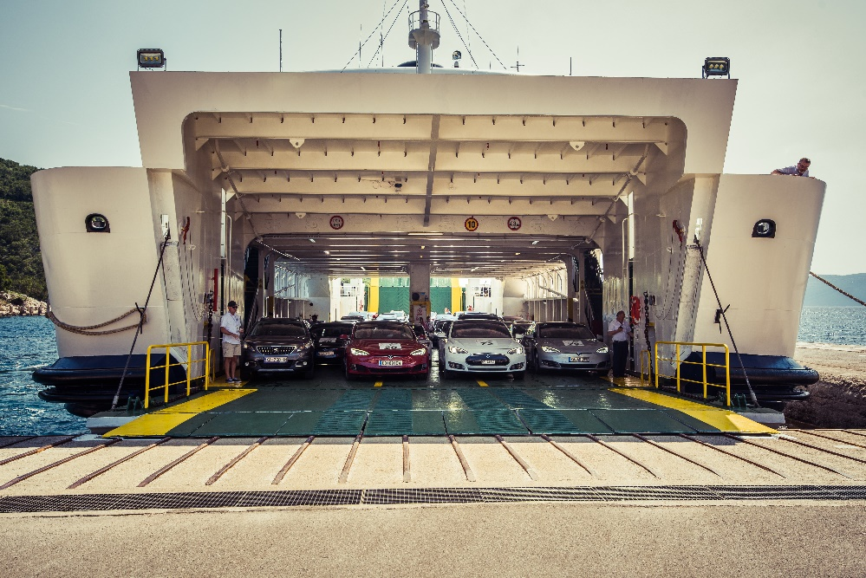
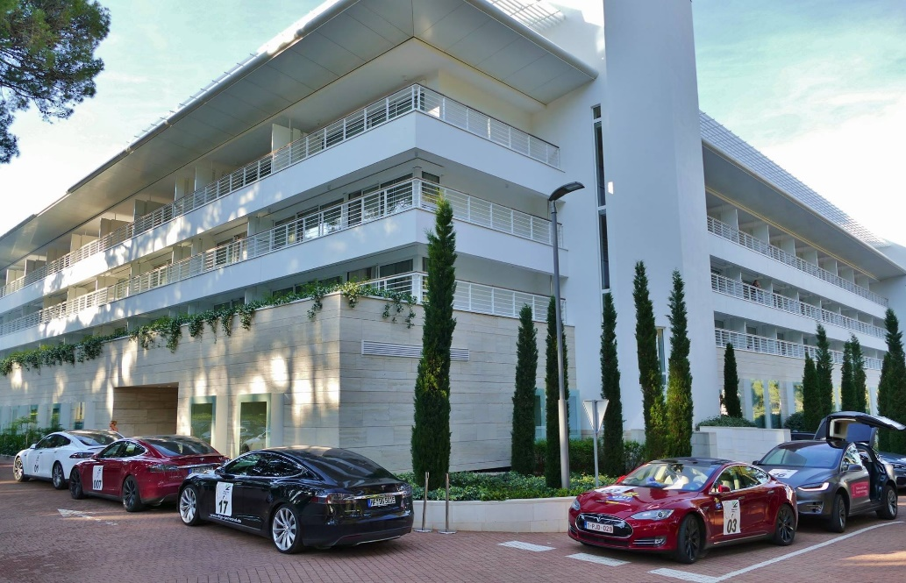
Nikola tesla ev RALLY CROATIA 2018
DAY 05.06. Rovinj –Motovun-Buzet-Cres-Mali Lošinj
Motovun: sightseeing
Buzet: Lunch
Roč: sightseeing
Cres: ACI Marina-Lunch
Mali Lošinj (hotel Bellevue)

Slide 7
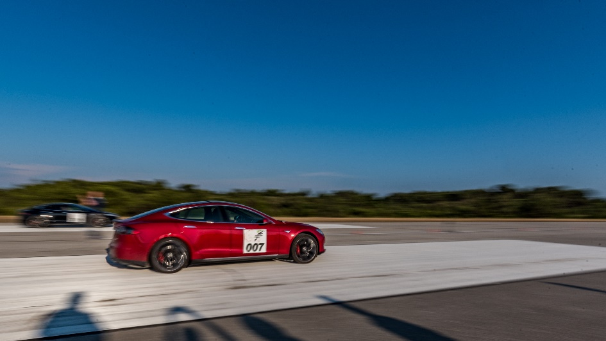
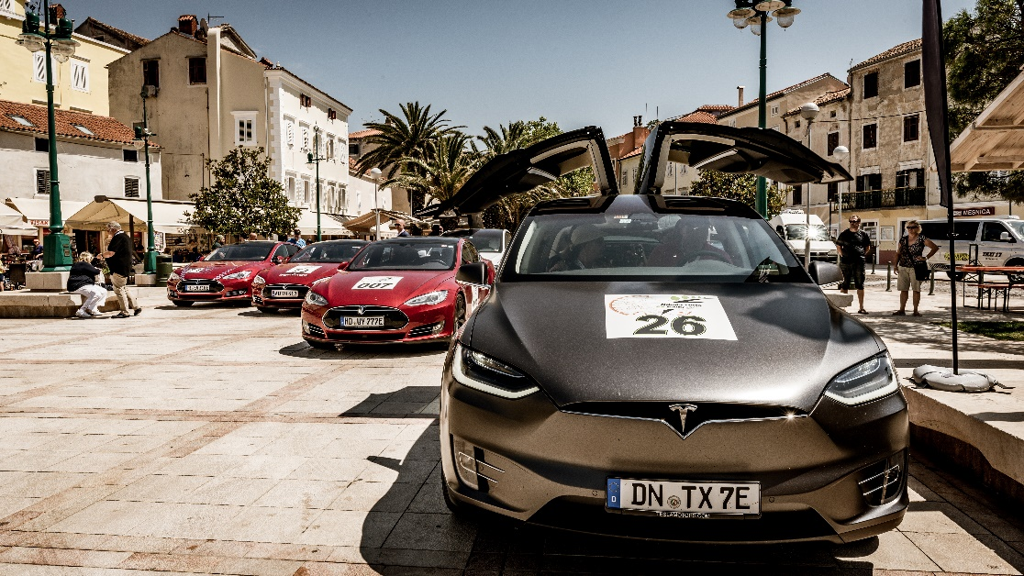
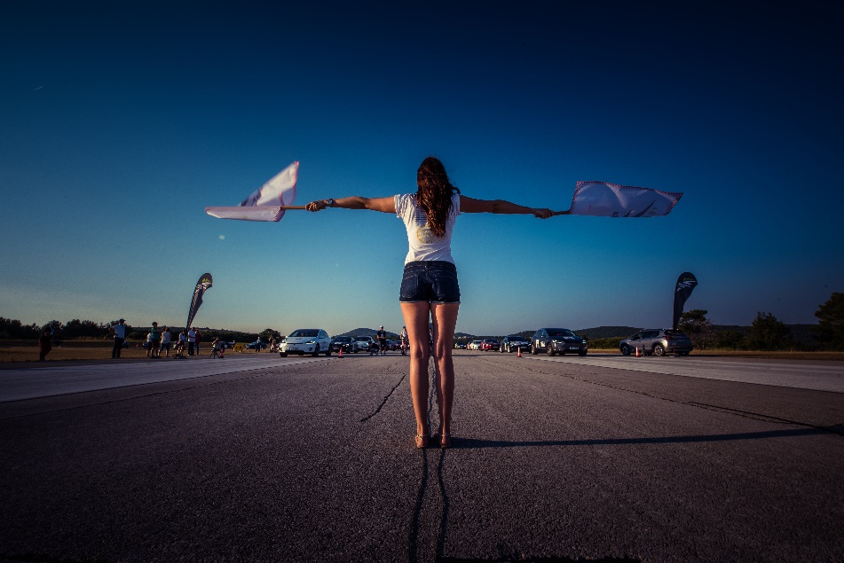
Nikola tesla ev RALLY CROATIA 2018
4. DAY 06.06. Mali Lošinj
Speed race – airport Mali Lošinj
Speed boat ride, diving, dolphin sight seeing, airplane ride,… choose your experience

Slide 8
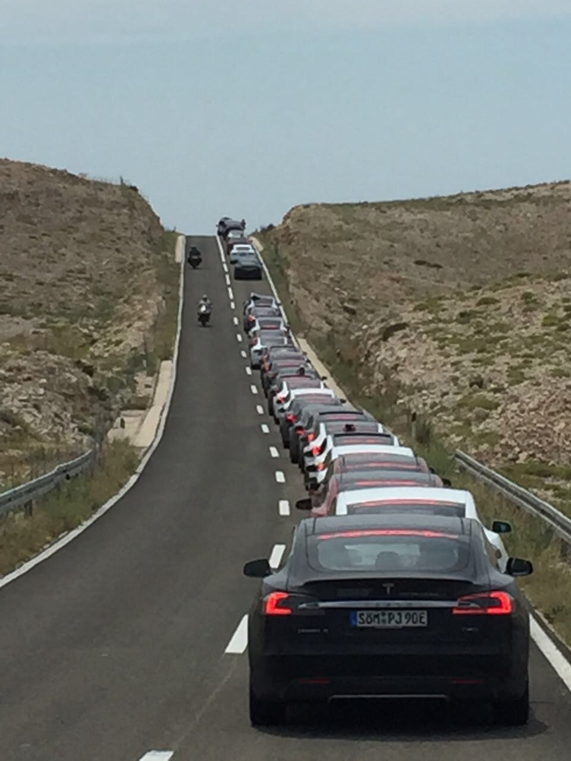
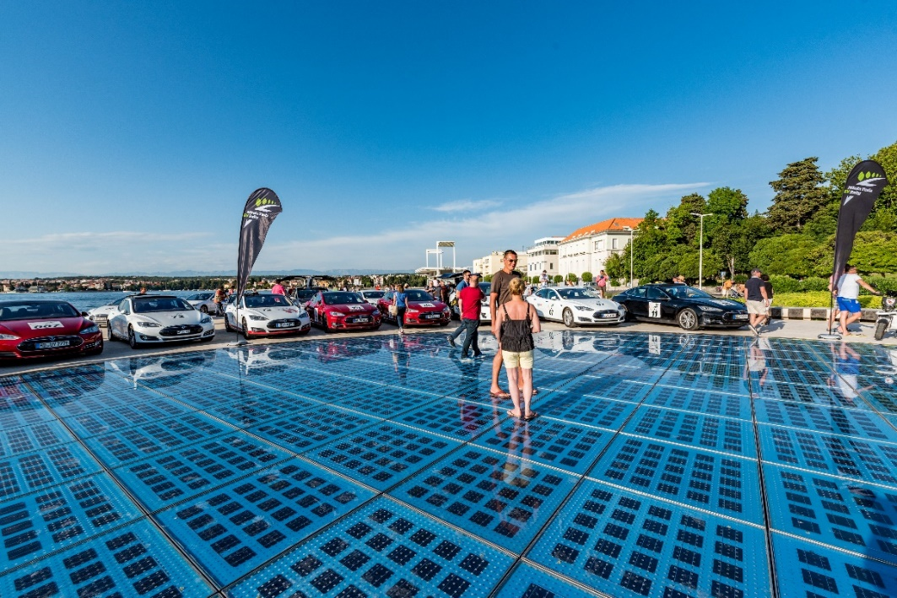
Nikola tesla ev RALLY CROATIA 2018
5. DAY 07.06. Mali Lošinj- Cres-Krk-
Pag- Zadar (4 Islands and
2 Ferry boats)
Lunch on Island Pag
Stop on “Greeting to Sun” –Zadar, solar panel installation

Slide 9
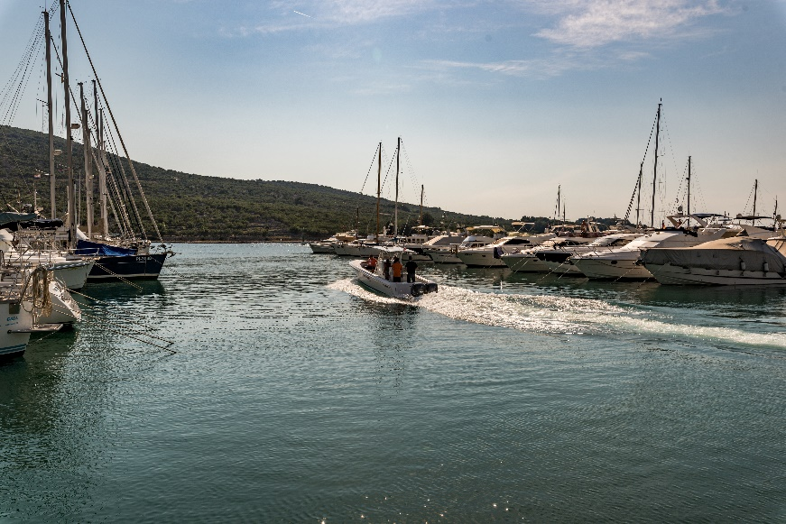
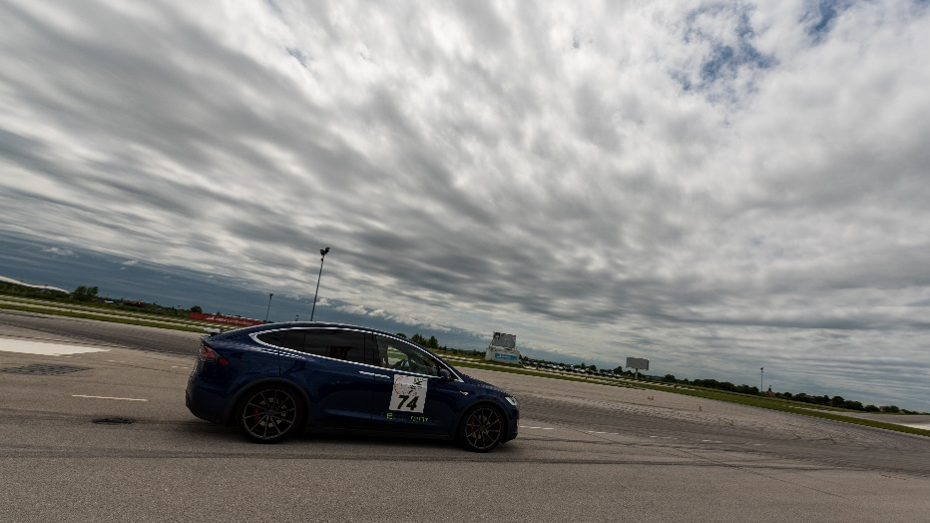
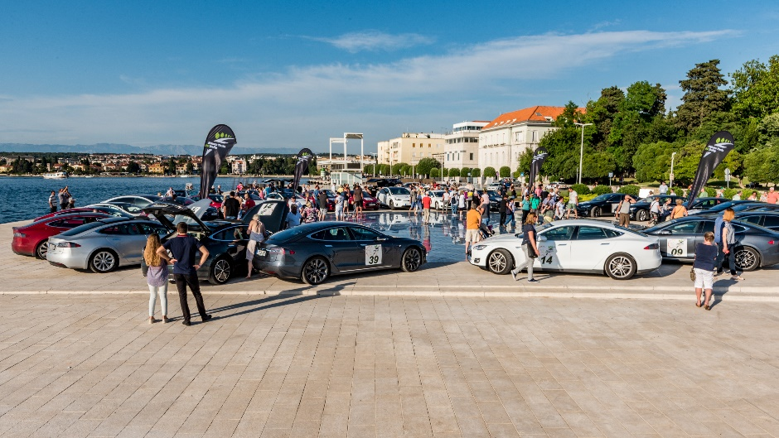
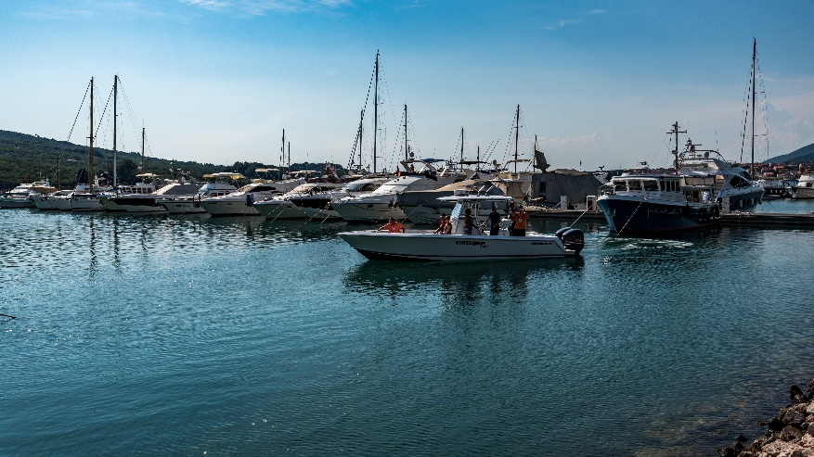
Nikola tesla ev RALLY CROATIA 2018
6. DAY 08.06. Zadar-Kornati Islands
Boat trip to Kornati (Lunch)
Speed race Airport Šepurine

Slide 10
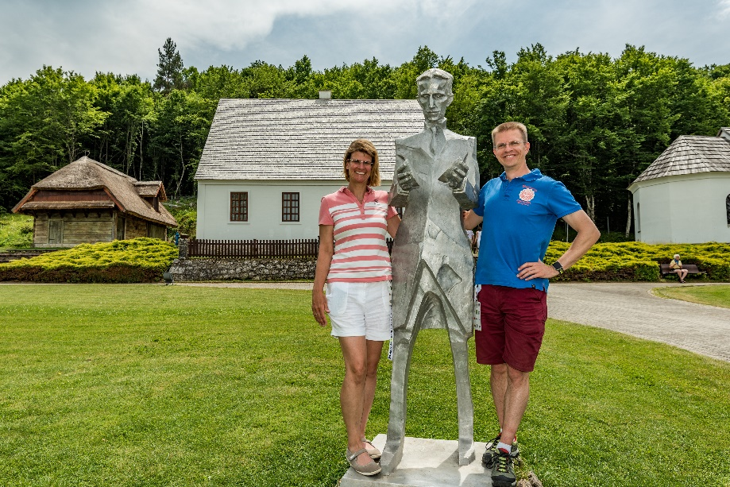
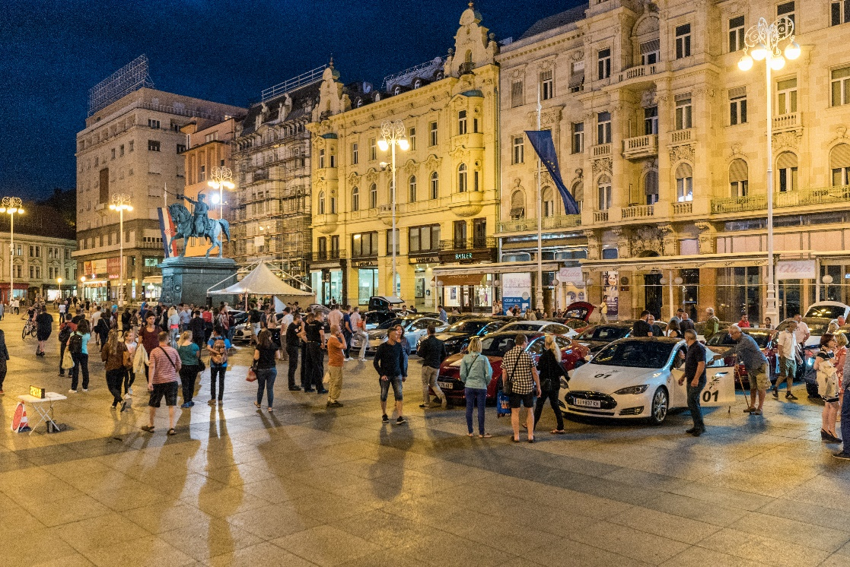
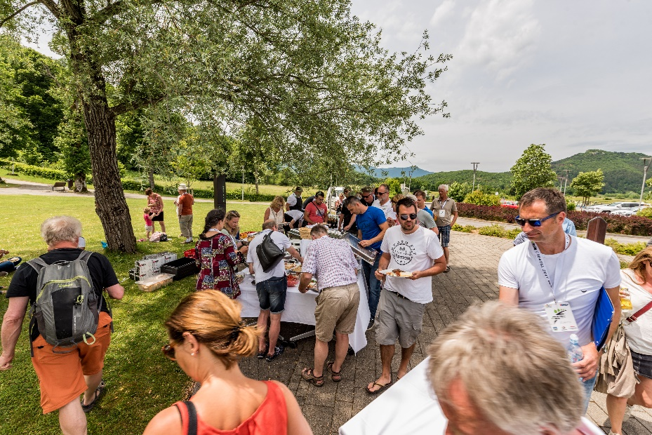
Nikola tesla ev RALLY CROATIA 2018
7. DAY 09.06.2018. Zadar-MC
Nikola Tesla Smiljan Gospić-
NP Plitvička Jezera – Zagreb
MC Nikola Tesla u Smiljanu: sightseeing and lunch
Plitvička Jezera: sightseeing
Zagreb – hotel Esplanade

Slide 11
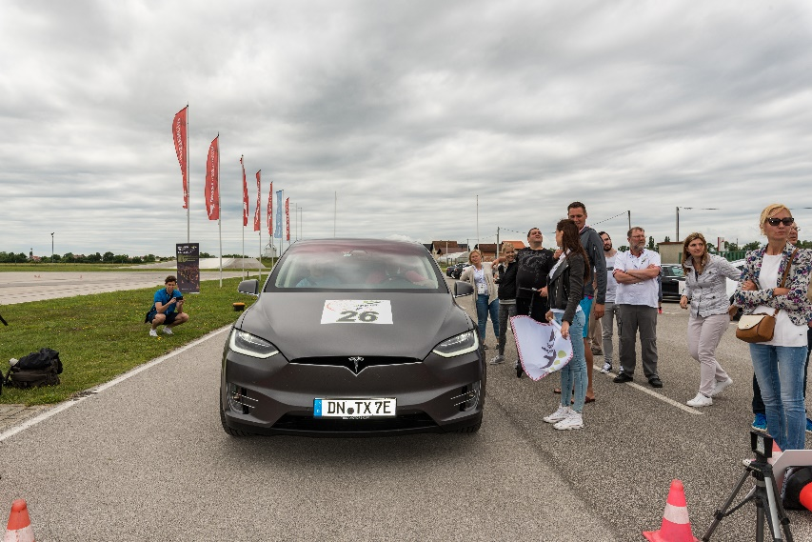
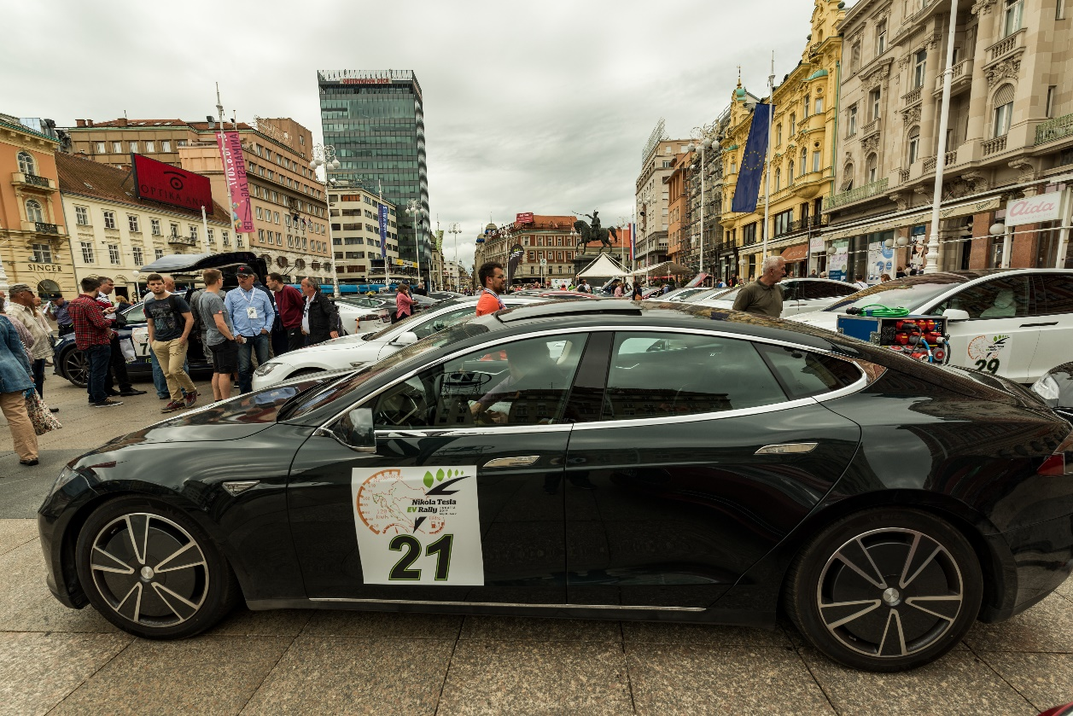
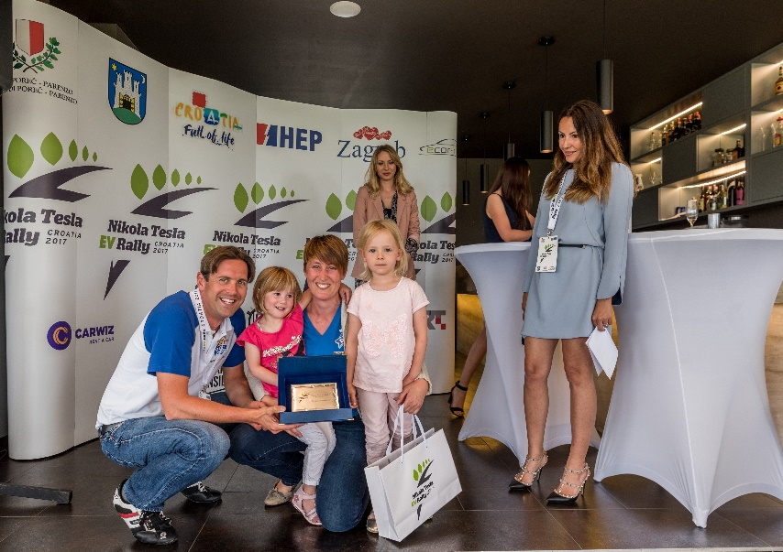
Nikola tesla ev RALLY CROATIA 2018
DAY 10.06.2017. Zagreb –
Trg Bana Jelačića
“Skill exam”-FINISH
Award ceremony and celebration lunch

Slide 12
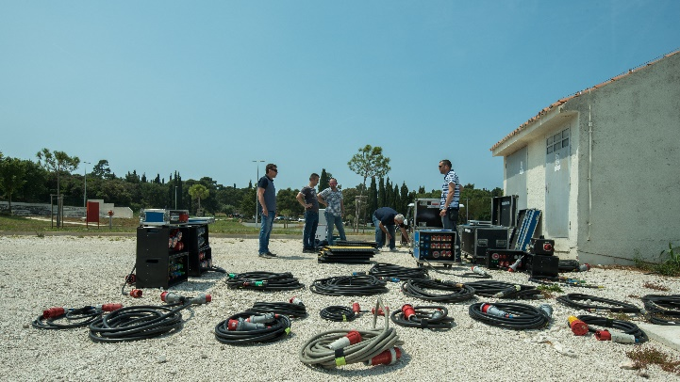
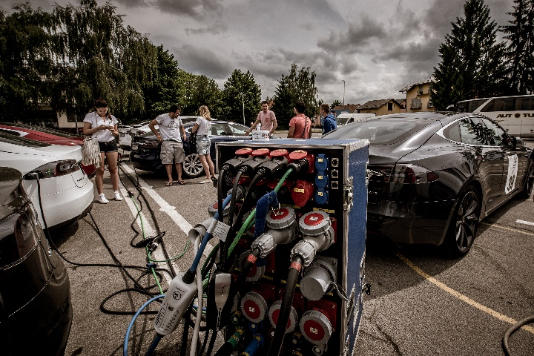
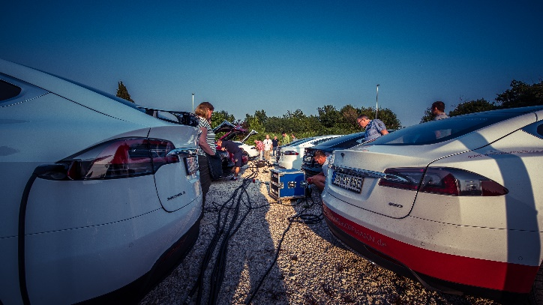
Nikola tesla ev RALLY CROATIA 2018
8 days, 15 cities, 5 Islands, 4 National Parks :
Rovinj,Poreč,Vodnjan,Vrsar, Motovun,
Buzet,Roč,Cres,Lošinj,Krk,Pag,Zadar,
Kornati, NP Plitvička Jezera, Zagreb
Charging is organized and secured for all participants on entire route (stop points and hotels)
Support of local local poice on entire route
Timeline is organized by Delta Timing team and is necessary to follow the start/finish time in “Road book” (it”s mandatory)

Slide 13

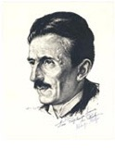

THANK YOU FOR YOUR ATTENTION!
E.V.A. Blue d.o.o.
"I don't regret that others stole my ideas.
I regret that they don't have their own."

